Slide 1

8th Grade Math: Pre-Algebra
Unit 1, Lesson 6 Writing and Solving Two-Step Equations Volume 1, pg. 31

Slide 2


Benchmark
MA.7.AR.2.2
Write and solve two-step equations in one variable within a mathematical or real-world context, where all terms are rational numbers.
volume 1, pg. 31

Slide 3
Integrated Mathematical Thinking and Reasoning Standards
MA.K12.MTR.3.1 Complete tasks with mathematical fluency.
MA.K12.MTR.4.1 Engage in discussions that reflect on the mathematical thinking of self and others.
MA.K12.MTR.5.1 Use patterns and structure to help understand and connect mathematical concepts.
MA.K12.MTR.7.1 Apply mathematics to real-world contexts.
volume 1, pg. 31

Slide 4

Learning Targets
I can solve a two-step equation within a mathematical or real-world context.
I can write a two-step equation given a real-world context.
volume 1, pg. 31

Slide 5

Warm-Up
volume 1, pg. 31

Slide 6
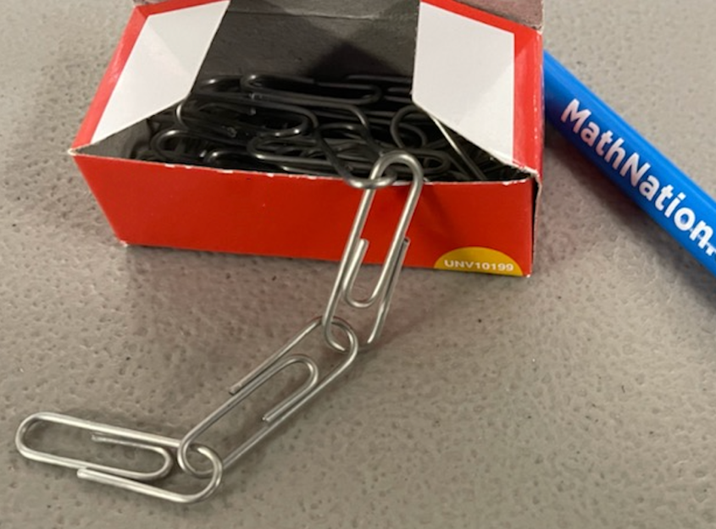
1.6.1 Warm-Up: Estimation
The picture shows $100$ #4 size paper clips with four clips chained together.
volume 1, pg. 31

Slide 7
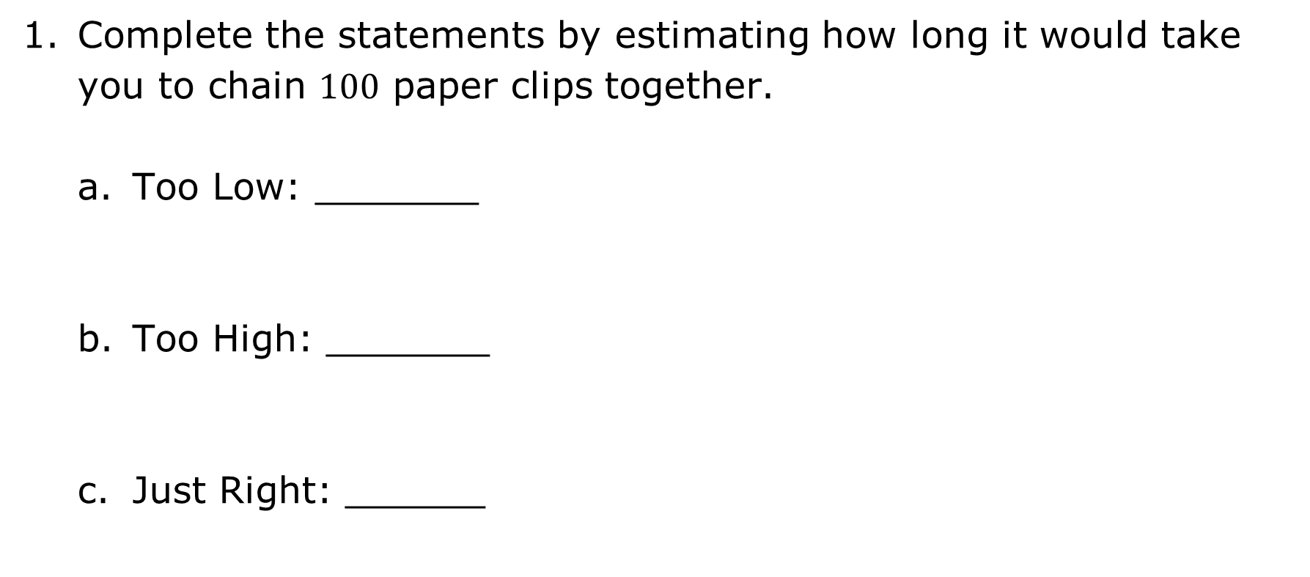
Complete the statements by estimating how long it would take you to chain $100$ paper clips together.
Too Low: _______
Too High: _______
Just Right: ______
volume 1, pg. 31

Slide 8

Guided Practice
volume 1, pg. 32

Slide 9

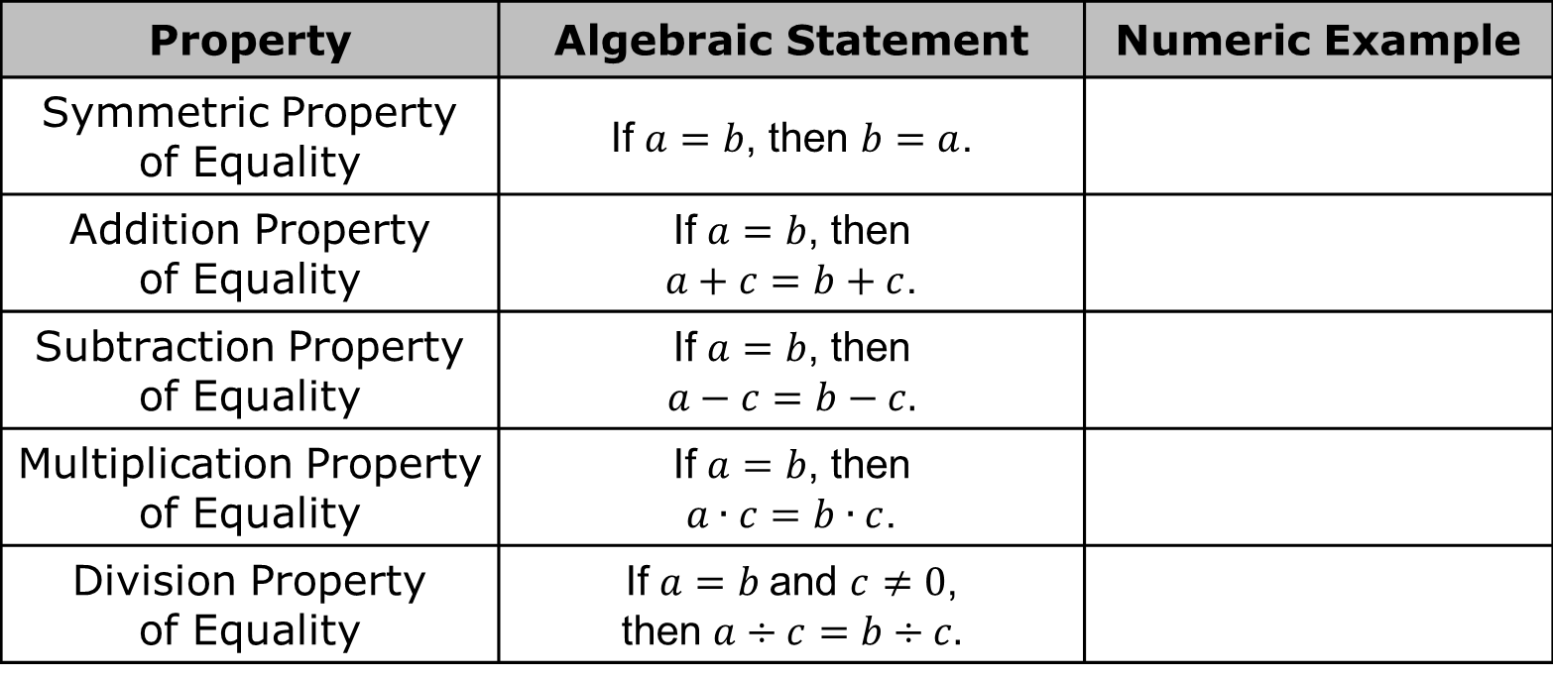
1.6.2 Guided Practice: Properties of Equality
Properties of equality can be used to solve equations.
Complete the table with a numeric example of each property of equality.
Property | Algebraic Statement | Numeric Example
Symmetric Property of Equality | If $a=b$, then $b=a$.
Addition Property of Equality | If $a=b$, then $a+c=b+c$.
Subtraction Property of Equality | If $a=b$, then $a−c=b−c$.
Multiplication Property of Equality | If $a=b$, then $a∙c=b∙c$.
Division Property of Equality | If $a=b$ and $c≠0$, then $a÷c=b÷c$.
volume 1, pg. 32

Slide 10
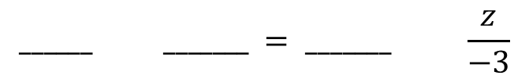
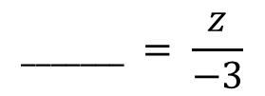

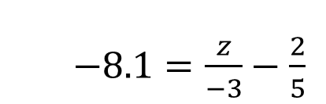
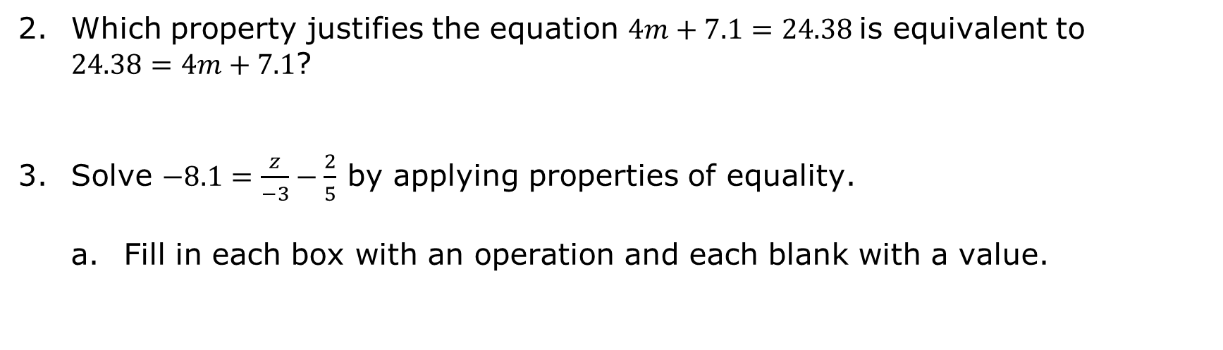

Which property justifies the equation $4m+7.1=24.38$ is equivalent to $24.38=4m+7.1$?
Solve $−8.1=\frac{z}{−3}−\frac{2}{5}$ by applying properties of equality.
Fill in each box with an operation and each blank with a value.
$−8.1=\frac{z}{−3}−\frac{2}{5}$
$−8.1 _______ = \frac{z}{−3}−\frac{2}{5} _______$
$$_______ = \frac{z}{−3}$$
$$______ _______ = _______ \frac{z}{−3}$$
$$_______ = z$$
volume 1, pg. 32

Slide 11
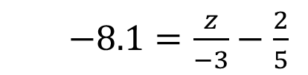
Use substitution in the original equation to verify the solution.
$−8.1=\frac{z}{−3}−\frac{2}{5}$
volume 1, pg. 32

Slide 12


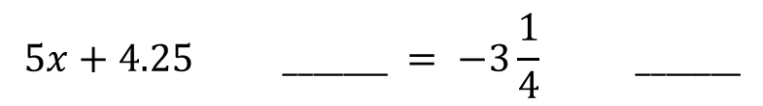
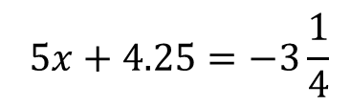
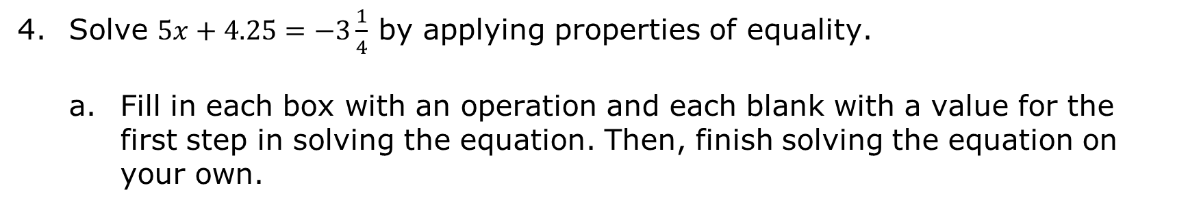
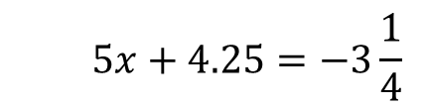
Solve $5x+4.25=−3\frac{1}{4}$ by applying properties of equality.
Fill in each box with an operation and each blank with a value for the first step in solving the equation. Then, finish solving the equation on your own.
$$5x+4.25=−3\frac{1}{4}$$
$$5x+4.25 _______ = −3\frac{1}{4} _______$$
$$5x=_______$$
$$x=_______$$
Use substitution in the original equation to verify the solution.
$$5x+4.25=−3\frac{1}{4}$$
volume 1, pg. 33

Slide 13

Try It
volume 1, pg. 33

Slide 14

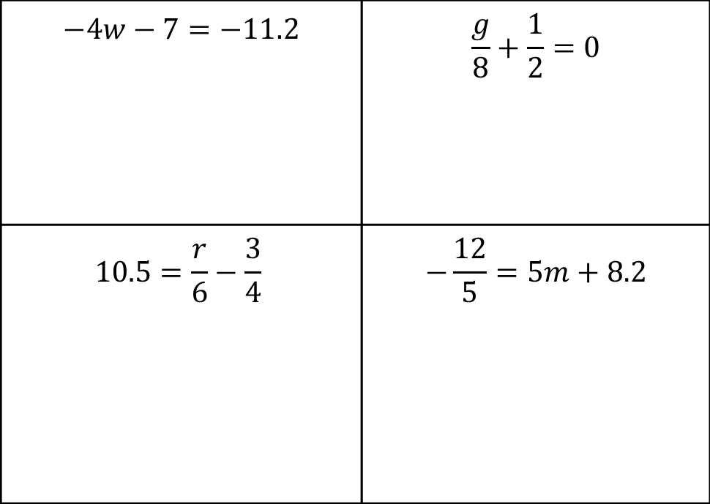
1.6.3 Try It: Solving Two-Step Equations
Solve each equation by applying properties of equality. Use substitution to verify the solutions for each equation.
$$−4w−7=−11.2$$ | $$\frac{g}{8}+\frac{1}{2}=0$$
$$10.5=\frac{r}{6}−\frac{3}{4}$$ | $$−\frac{12}{5}=5m+8.2$$
volume 1, pg. 33

Slide 15

Collaboration
volume 1, pg. 34

Slide 16

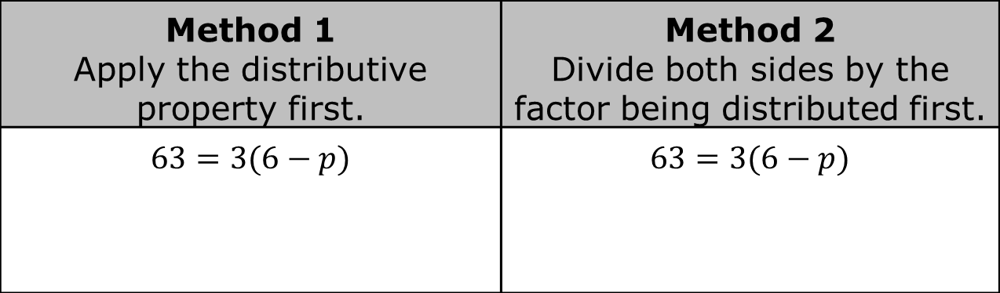
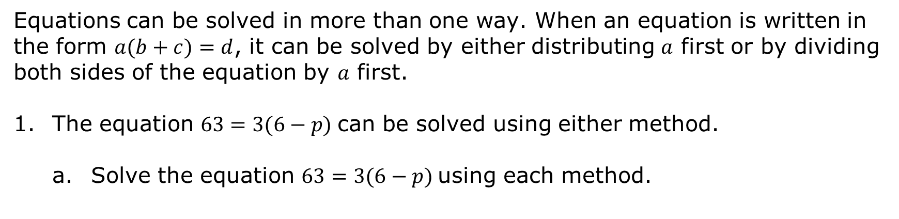
1.6.4 Collaboration: Using the Distributive Property
Equations can be solved in more than one way. When an equation is written in the form $a(b+c)=d$, it can be solved by either distributing $a$ first or by dividing both sides of the equation by $a$ first.
The equation $63=3(6−p)$ can be solved using either method.
Solve the equation $63=3(6−p)$ using each method.
Method 1 Apply the distributive property first. | Method 2 Divide both sides by the factor being distributed first.
$63=3(6−p)$ | $63=3(6−p)$
Verify that the solution is correct using substitution.
volume 1, pg. 34

Slide 17

Guided Instruction
volume 1, pg. 34

Slide 18
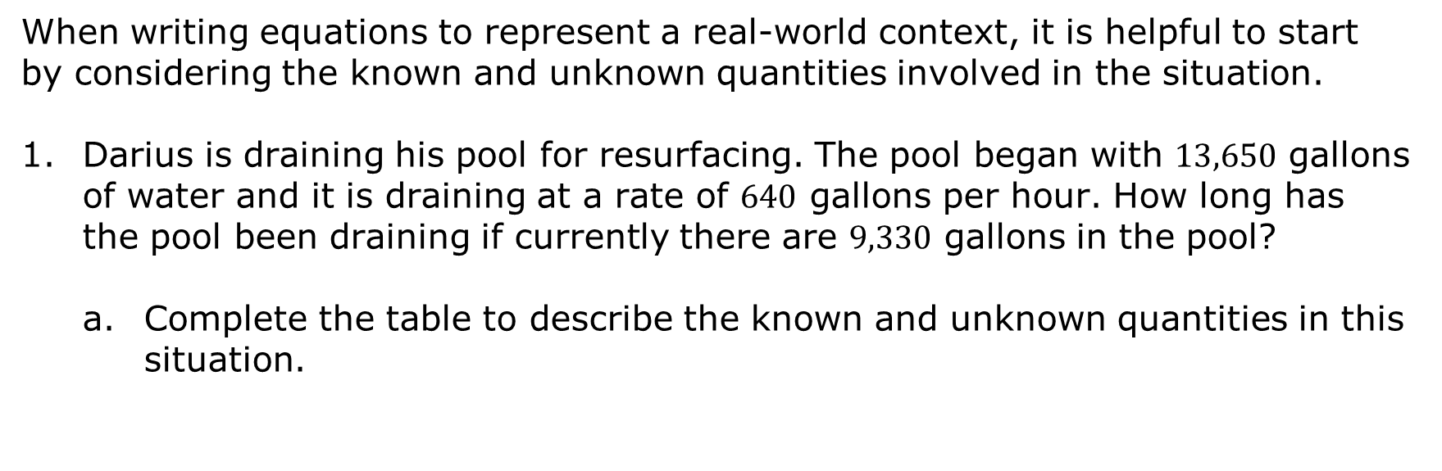
1.6.5 Guided Instruction: Writing a Two-Step Equation from a Real-World Context
When writing equations to represent a real-world context, it is helpful to start by considering the known and unknown quantities involved in the situation.
Darius is draining his pool for resurfacing. The pool began with $13,650$ gallons of water and it is draining at a rate of $640$ gallons per hour. How long has the pool been draining if currently there are $9,330$ gallons in the pool?
Complete the table to describe the known and unknown quantities in this situation.
Known Quantities | Unknown Quantities
volume 1, pg. 34

Slide 19
With your partner, discuss how the quantities are related in this situation. Summarize your discussion.
volume 1, pg. 34

Slide 20

When writing equations to represent real-world contexts, any variables used must be defined to identify which quantity each variable in the equation represents.
Define the unknown quantity using a variable.
Write an equation that could be used to find the unknown quantity using the variable you defined.
Solve the equation.
Explain what the solution means in this context.
volume 1, pg. 35

Slide 21
Try It
volume 1, pg. 35

Slide 22
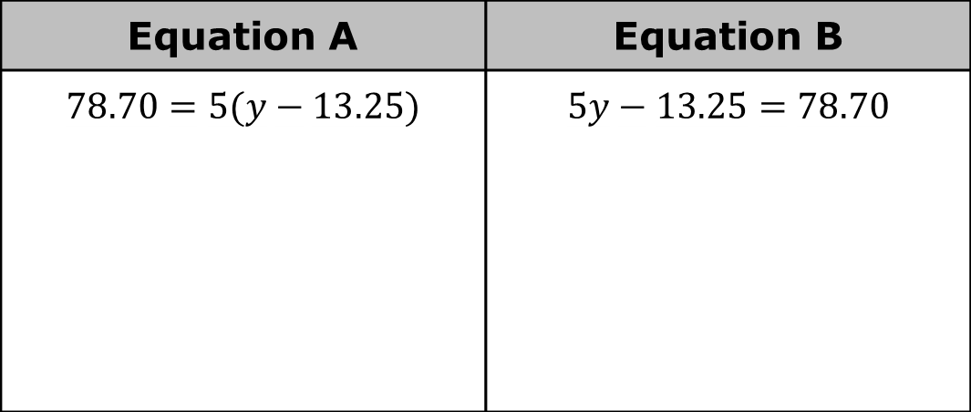
1.6.6 Try It: Relating Equations to Their Contexts
Work with your partner to complete the following.
Two equations are shown.
Solve both equations. Show your work.
Equation A | Equation B
$$78.70=5(y−13.25)$$ | $$5y−13.25=78.70$$
volume 1, pg. 35

Slide 23
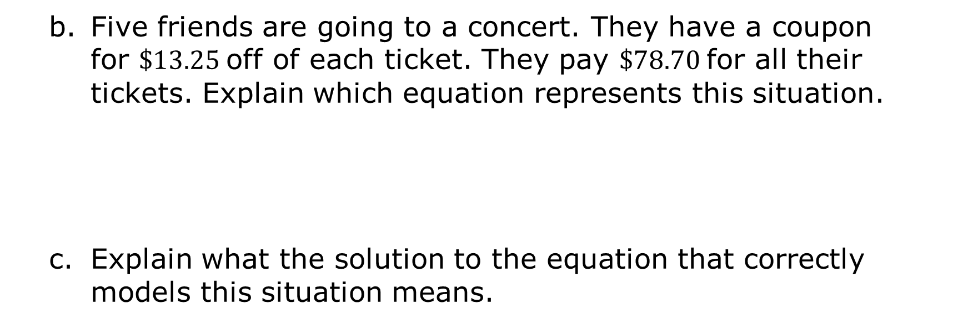
Five friends are going to a concert. They have a coupon for $\$13.25$off of each ticket. They pay $\$78.70$ for all their tickets. Explain which equation represents this situation.
Explain what the solution to the equation that correctly models this situation means.
volume 1, pg. 35

Slide 24

Wrap-Up
volume 1, pg. 36

Slide 25
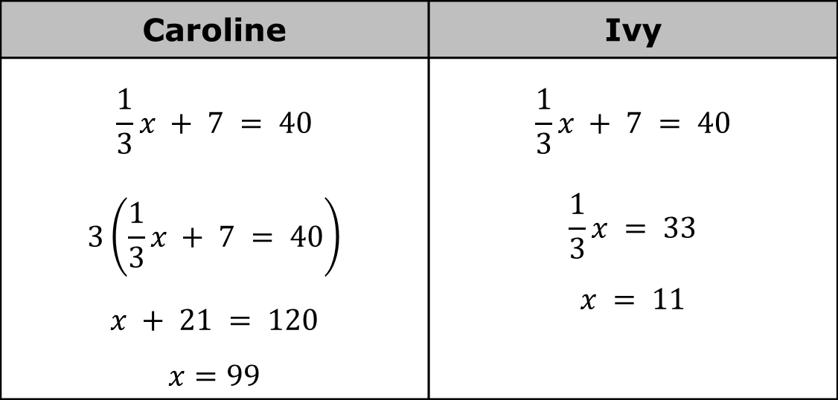
1.6.7 Wrap-Up: Error Analysis
Two students solved an equation. One student made a mistake. Their work is shown below.
Caroline | Ivy
$$\frac{1}{3}x + 7 = 40$$ $$3\left(\frac{1}{3}x + 7 = 40\right)$$ $$x + 21 = 120$$ $$x=99$$ | $$\frac{1}{3}x + 7 = 40$$ $$\frac{1}{3}x = 33$$ $$x = 11$$
volume 1, pg. 36

Slide 26
Which student made an error when solving the equation?
Explain what error the student made.
volume 1, pg. 36

